Slide 1

COSI Transmit: Open Source Soft- and Hardware Transmission System for traditional and rotating MR
Christian Blücher¹, Haopeng Han¹, Werner Hoffmann², Reiner Seemann², Frank Seifert², Thoralf Niendorf^{1,3,4} and Lukas Winter¹
¹ Berlin Ultrahigh Field Facility (B.U.F.F.), Max-Delbrück Center for Molecular Medicine in the Helmholtz Association, Berlin, Germany
² Physikalisch Technische Bundesanstalt (PTB), Berlin, Germany
³ Experimental and Clinical Research Center, a joint cooperation between the Charité Medical Faculty and the Max Delbrück Center for Molecular Medicine in the Helmholtz Association, Berlin, Germany
⁴ MRI.TOOLS GmbH, Berlin, Germany

Slide 2

Declaration of Financial Interests or Relationships
Speaker Name: Lukas Winter
I have no financial interests or relationships to disclose with regard to the subject matter of this presentation.

Slide 3

Motivation
Magnetic Resonance Imaging (MRI) is an essential medical diagnostic tool that is beyond the reach of many patients throughout the world¹
A goal of the open source imaging initiative (OSI²) is to collaboratively build an affordable open source MR for research, education and the clinic
In this work we present our efforts towards an affordable open source transmission and reception system for traditional and rotating MR: spectrometer, RF power amplifier, T/R switch, LNA and RF coil
¹ World Health Organization (WHO), (2013, 25. Feb.), Essential Health Technologies: Medical Equipment – Data by Country; Available: http://gamapserver.who.int/gho/interactive_charts/health_technologies/medical_equipment/atlas.html

Slide 4
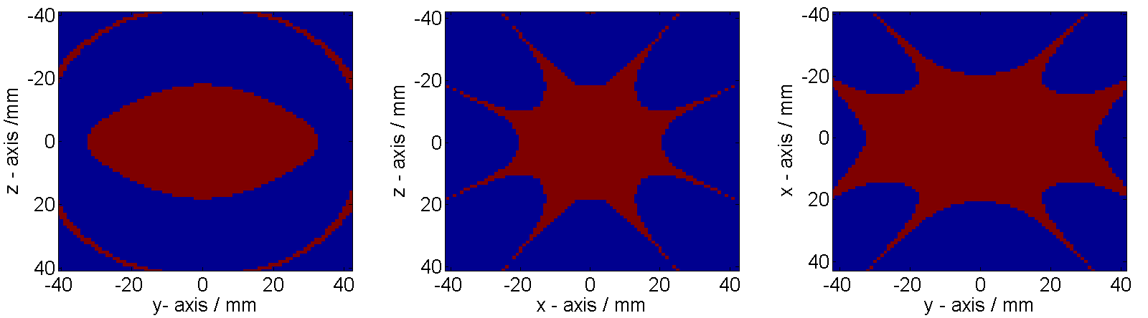
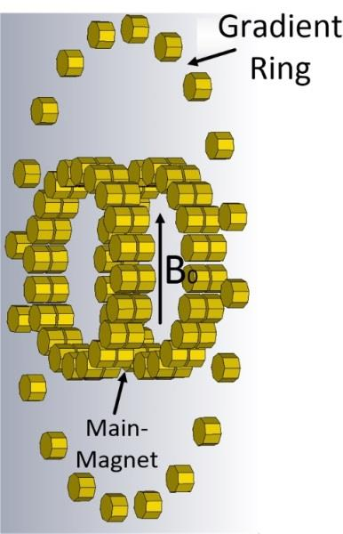
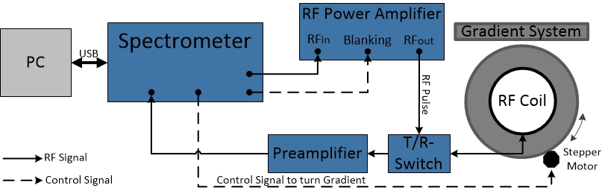
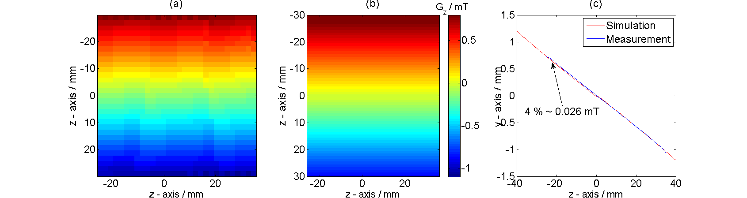
Towards an Open Source Desktop MR
Rotated permanent magnets can be used for spatial encoding [4-5]
Combining homogeneous main magnet with a linear gradient using permanent magnets [6-7]
Main magnet (B0=0.09T): 1000ppm -> (40x64x36)mm³
Linear Halbach gradient
measurement
simulation
[4] Cooley CZ, et al., Magn Reson Med, 2015, 73:p872-883 [5] Cooley CZ, et al., ISMRM, 2016, #3556 [6] Winter L, et al., ISMRM, 2016, #3586 [7] Blümler P, Concepts Magn Reson Part B Magn Reson Eng, 2016

Slide 5
Spectrometer Hardware
Published spectrometers require custom circuitboard design⁶⁻⁸
A software defined radio (SDR) is a programmable hardware device that allows the realization of radio/communication system in software and has recently been used as an MR spectrometer⁹
GNU Radio compatible SDRs allow to separate software developments of MR imaging techniques from hardware developments
Utilization of a USRP1¹⁰ equipped with 2 TX- and 1 RX-daughterboard
System functionality of spectrometer is defined in a GNU Radio Flowgraph utilizing the software package gr-MRI⁹
⁶ Asfour A, et al., Sensors, 2015; 13:16245-16262
⁷ Takeda K, J. Magn. Reson., 2008; 192:218:229
⁸ Chen HY, et al., J. Magn. Reson., 2015; 255:100-105
⁹ Hasselwander CJ, et al., J. Magn. Reson., 2016; 270:47:55
¹⁰ Ettus Research, USRP1, (2016, 18 Oct.); Available: https://www.ettus.com/product/details/USRPPKG

Slide 6
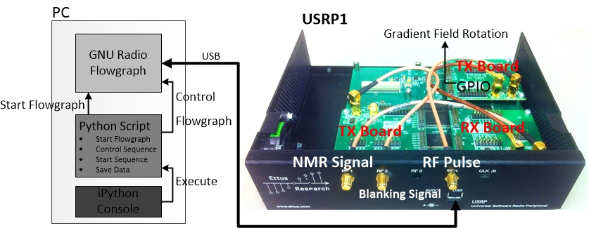
Spectrometer
Schematic of the implemented SDR spectrometer

Slide 7
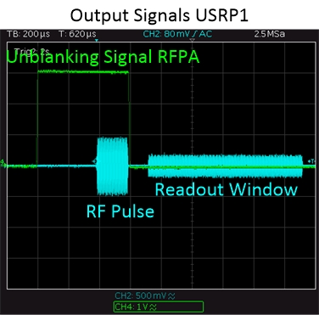
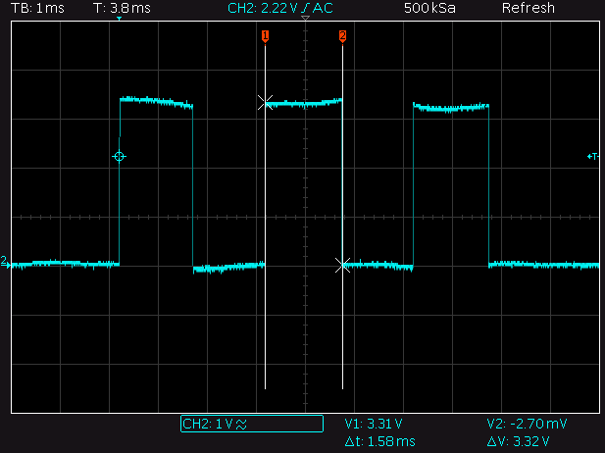
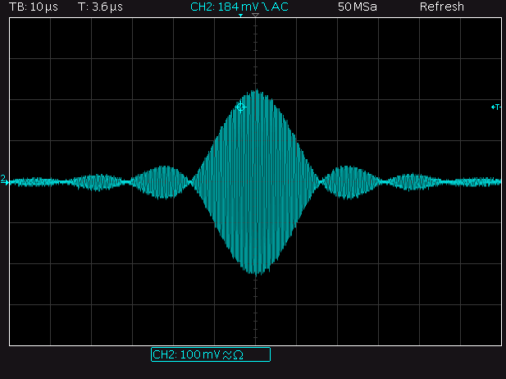
Results – Spectrometer
RF-pulses, RF power amplifier un-/blanking signals, data recording and stepper motor control signals can be generated
Pulse length and amplitude, readout-length and –delay can be freely chosen
Arbitrary shaped RF-pulses can be generated (f=0-30MHz)
RF-pulse, unblanking and readout window
Signal to control stepper motor
Sinc-pulse

Slide 8
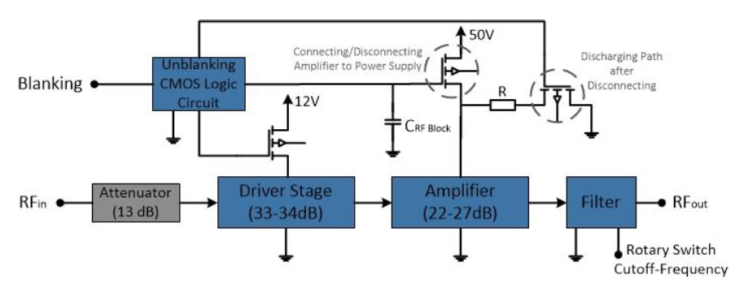
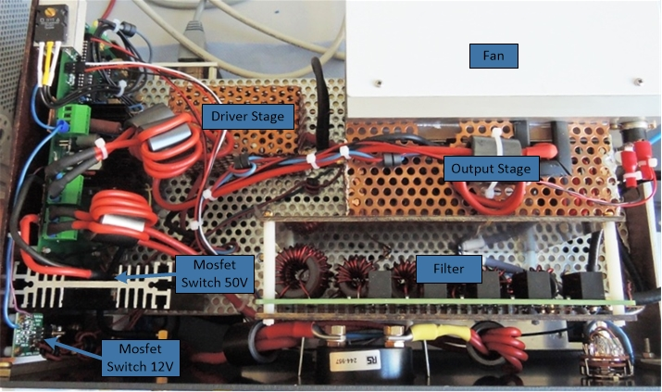
Results - RF Power Amplifier
Frequency Range: 1.8-54MHz (B0=0.043-1.27MHz)
Power: 1kW
Driver¹: two stage linear amp, Pout=5W, 33-34dB, 12V
Amp²: class AB, LDMOS (BLF188XR), Pmax=1400W, 50V
Filter³: 6-segment selectable low pass filter
¹http://www.box73.de/product_info.php?products_id=1899&XTCsid=86316710323ff4c b4d6e8857b9a31277 ²http://www.w6pql.com/1_kw_sspa_for_1_8-54_mhz.htm
³http://www.w6pql.com/a_1.5kw_lpf_for_160-6m.htm
Notes:
Driver: two stage linear amplifier design, qrp, 33-34dB gain, Pout=5W, 12V dc
Amp: classAB, LDMOS (BLF188XR), 50Vdc
Filter: 6-segment, selectable low pass filter

Slide 9
Results – RF Power Amplifier
Input power Pin plot versus output power Pout of RFPA → RFPA shows good linearity over investigated frequency range
→ RFPA shows good linearity over the investigated frequency range

Slide 10
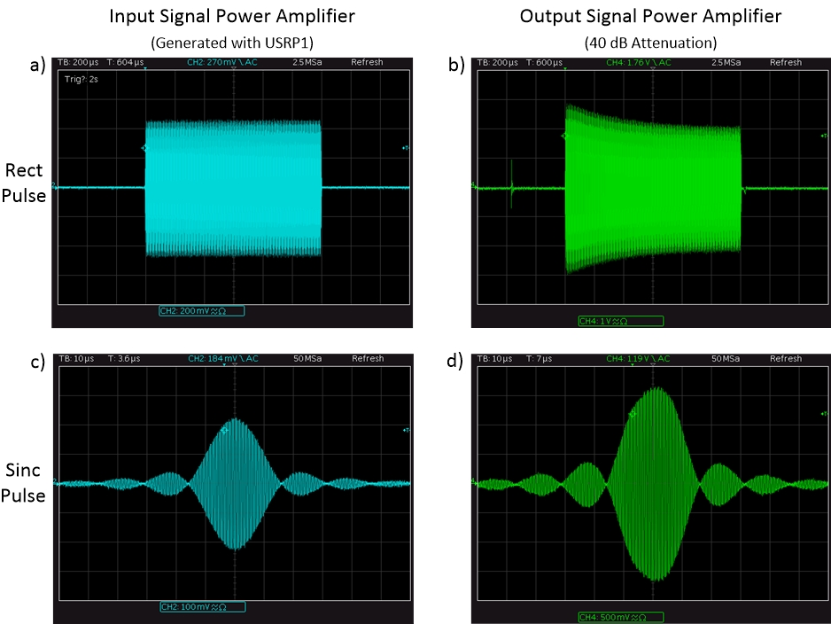
Results – RF Power Amplifier with blanking circuit

Slide 11
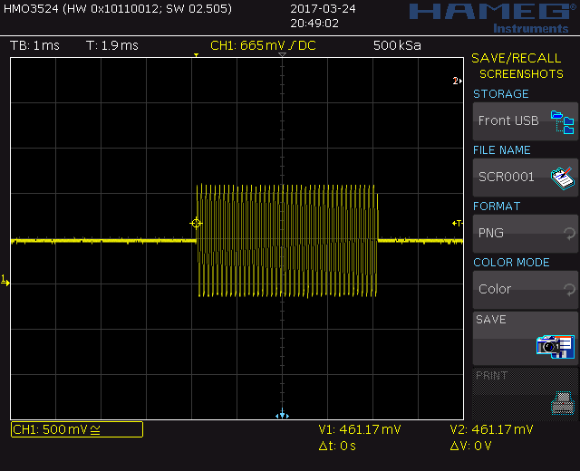
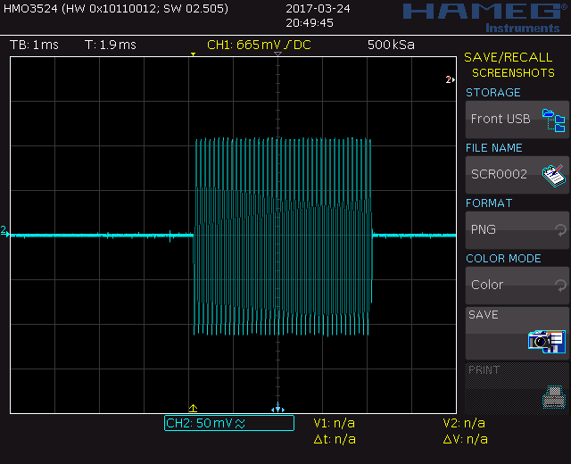
Results – RF Power Amplifier without blanking circuit
SDR output
RFPA output

Slide 12
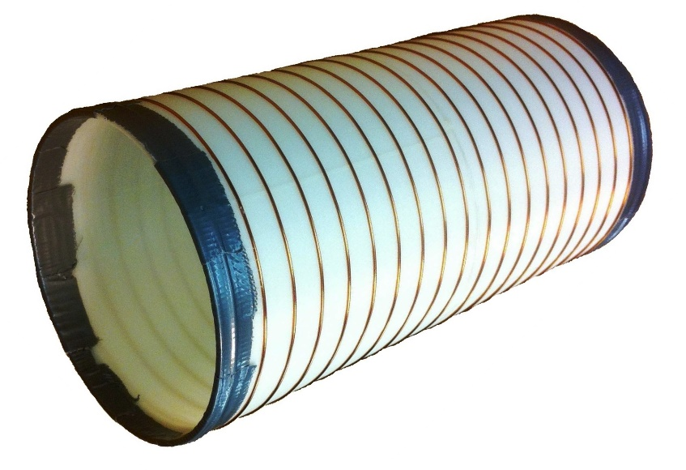
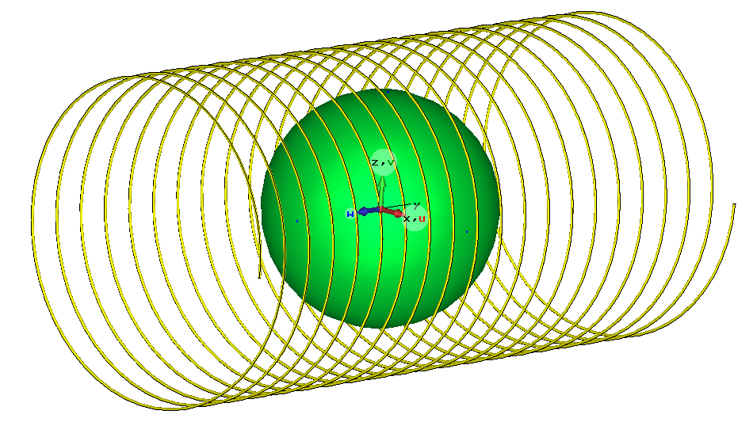
Results - RF Coil
Electromagnetic simulations (CST MWS 2012)
Solenoid RF coil to adapt to Halbach B₀ field distribution
Adaptation of RF coil length (l) and number of turns (N) in order to reach a homogeneous B1⁺ field distribution within a sphere (d=70mm)
f=3.63MHz, d_{inner}=96mm based on prototype Halbach magnet
AWG 20 copper wire as an electrical conductor
Final design: l=200mm, N=20

Slide 13
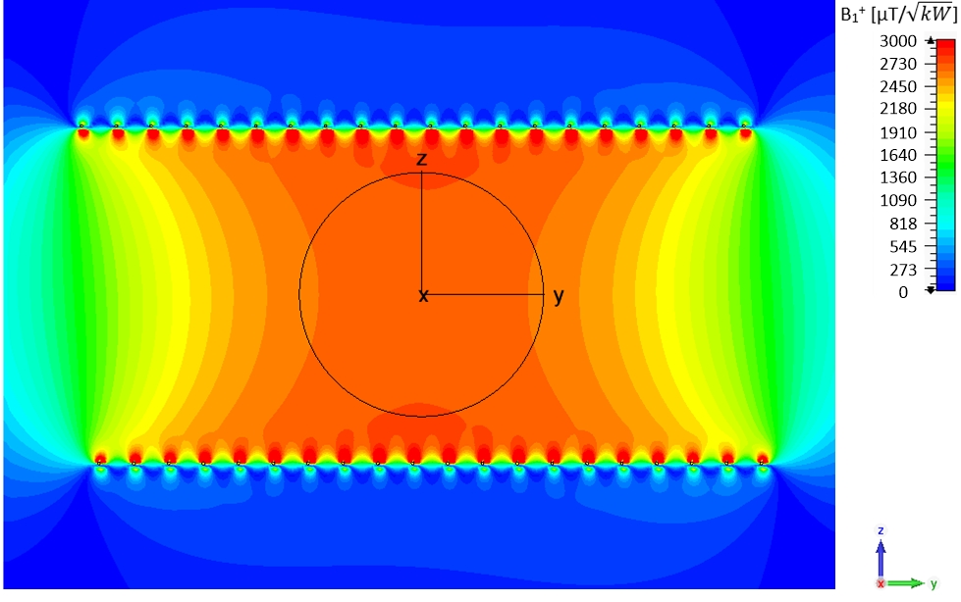
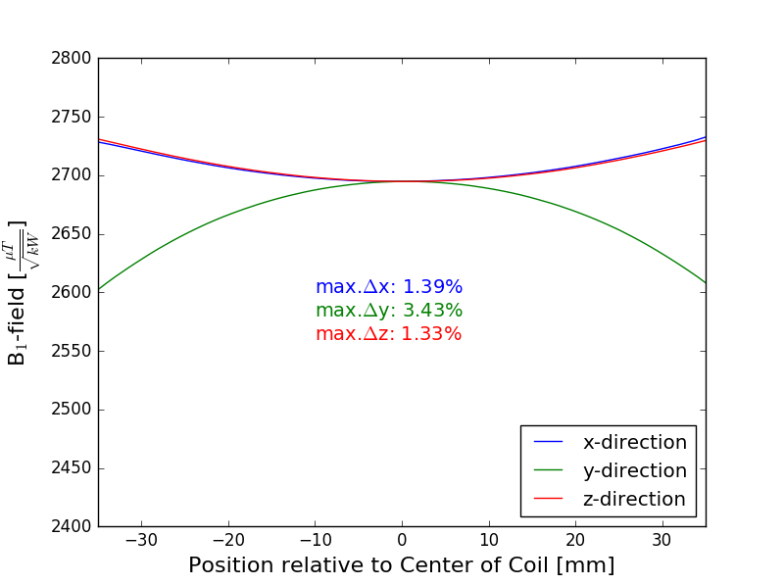
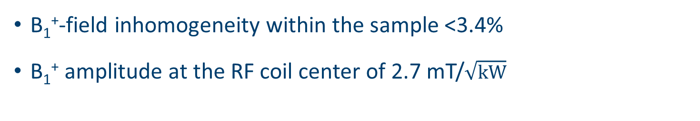
Results – RF Coil Simulations
B₁⁺-field inhomogeneity within the sample <3.4%
B₁⁺ amplitude at the RF coil center of 2.7 mT/$\sqrt{kW}$

Slide 14
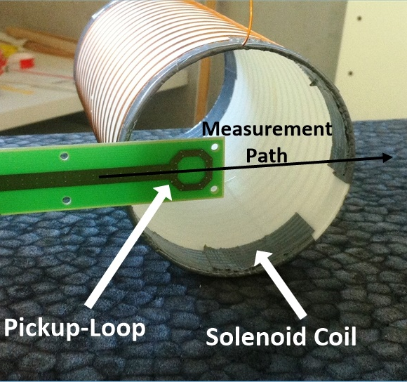
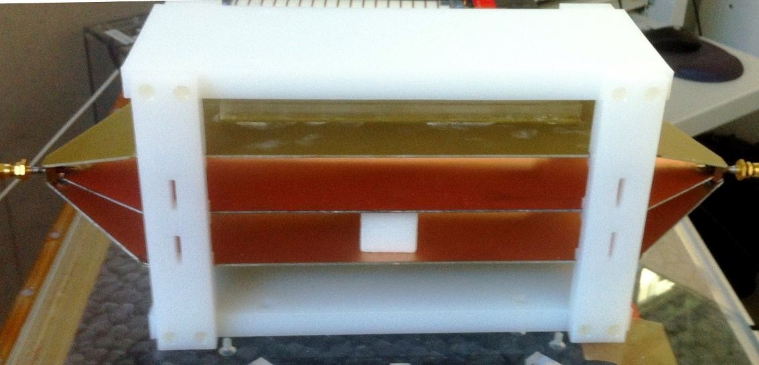
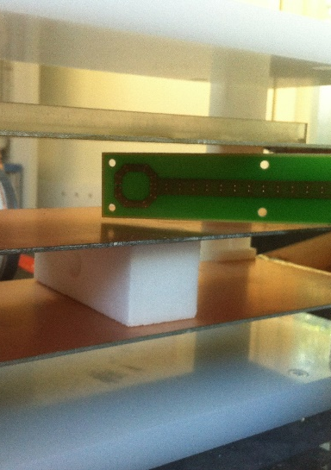
Results – RF Coil Measurements
Measured Q-factors: Q_{unloaded} = 94 → 38kHz bandwidth Q_{loaded} = 77 → 47kHz bandwidth
B₁⁺-field measurements with pickup loop positioned along straight line at one end of RF coil
Pickup loop calibration in known B field of TEM cell¹¹
RF coil measurements
TEM Cell
Pickup loop
calibration
¹¹ Klepsch T, et al., Biomed Tech, 2012; 57:119-122

Slide 15
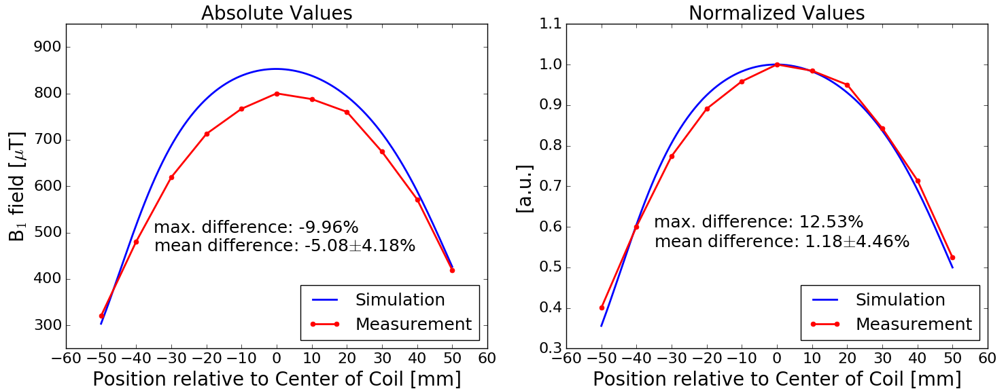
Results - Comparison Measurements vs. Simulations
Absolute and normalized comparison of simulated and measured B₁⁺ values of RF coil
Absolute difference: -5.1±4.2% (mean±std)
Normalized difference: 1.2±4.5% (mean±std)

Slide 16
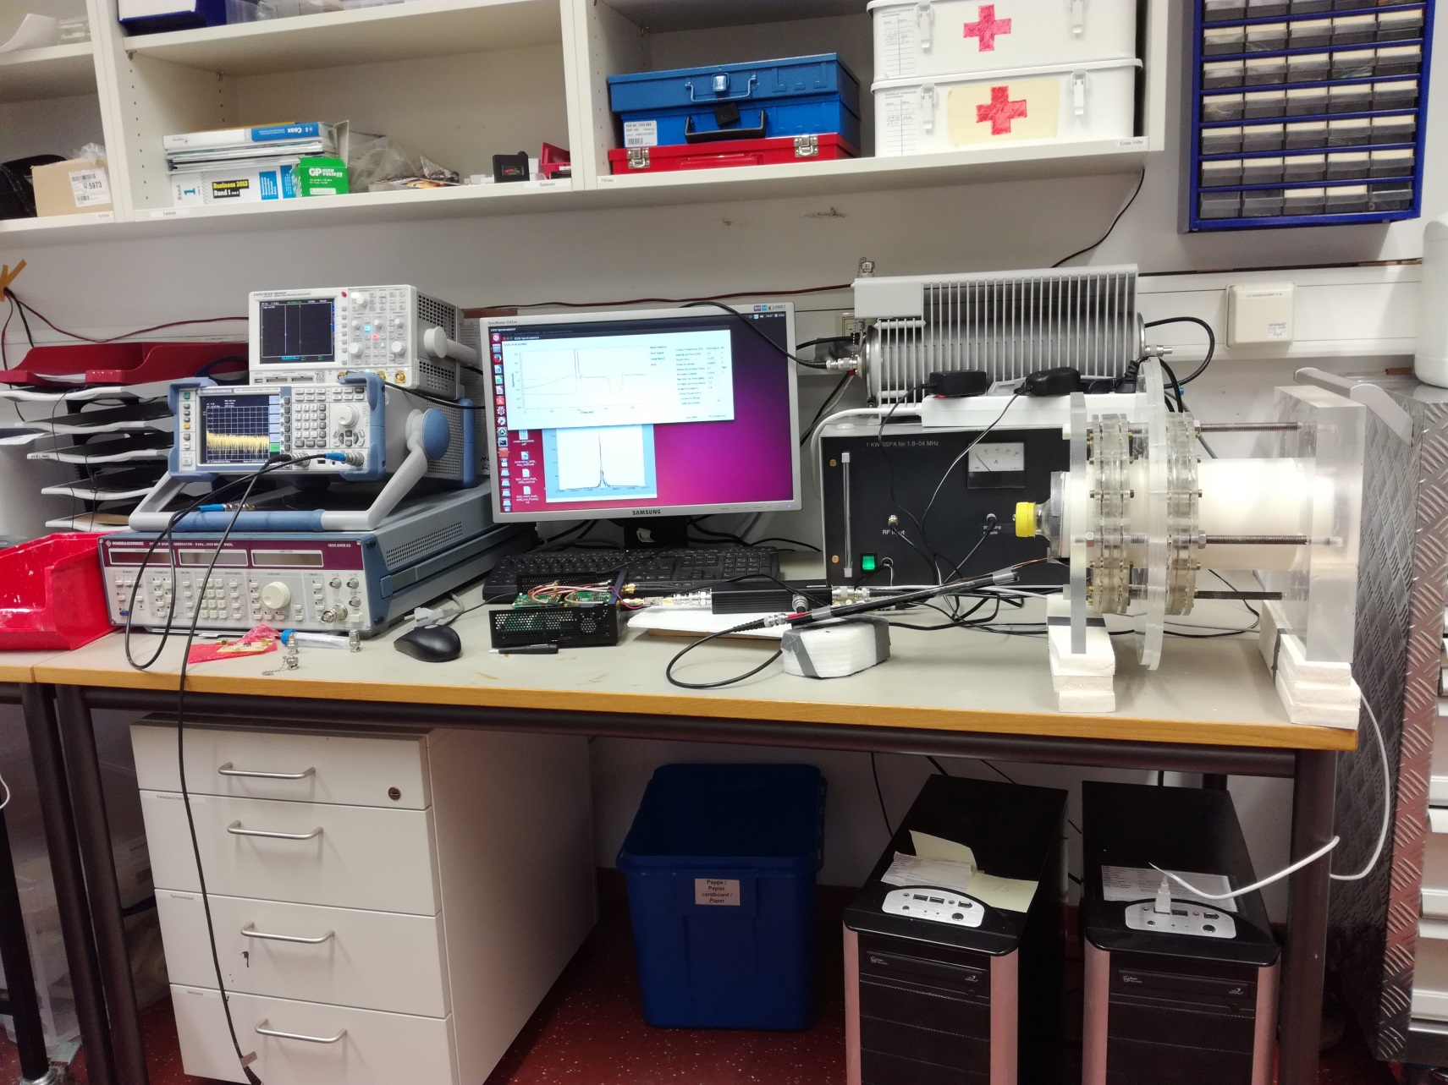
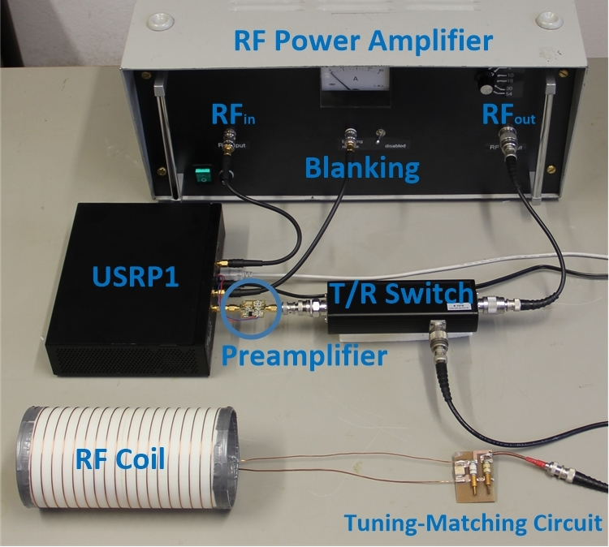
Result – COSI Transmission/Reception System
SDR:
f=0-30MHz
RFPA:
f=1.8-54MHz
P_{out}=1kW (peak)
RF coil:
l=200mm
d=96mm
T/R switch¹²:
f=3-5MHz
P_{in_max}=1.3kW
Preamplifier¹³:
f=150kHz-30MHz
Gain=18-20dB
Noise figure=1-2dB
Desktop MR (B0=0.08T) cost:
~160 USD for magnet
~1600 USD for 1kW RFPA
~1000 USD for SDR
~400 USD for T/R switch
~30 USD for LNA
<4000 USD for complete system
¹² NMR Service GmbH, Erfurt, Germany ¹³ LNA4HF, 9A4QV, (2016, 15. Nov.) Available: http://lna4hf.blogspot.de/

Slide 17

Conclusion
SDR is capable of producing arbitrary shaped RF pulses, un/blanking the RFPA, recording acquired data and controlling rotated gradient fields (f=0-30MHz)
RFPA (f=1.8-54MHz, P_{max}=1kW)
All project related files will be made available open source
Step by step towards a fully open source desktop MR system for research, education and the clinic

Slide 18
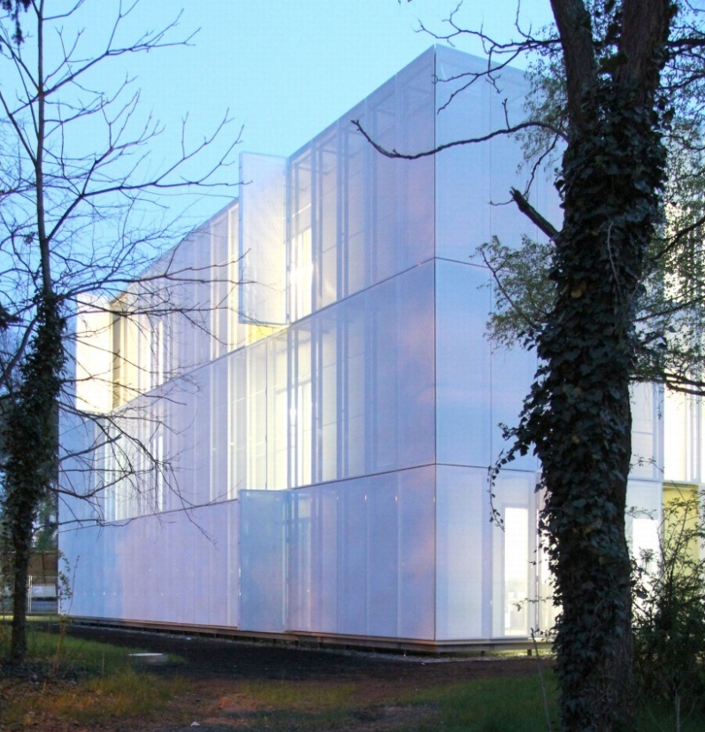

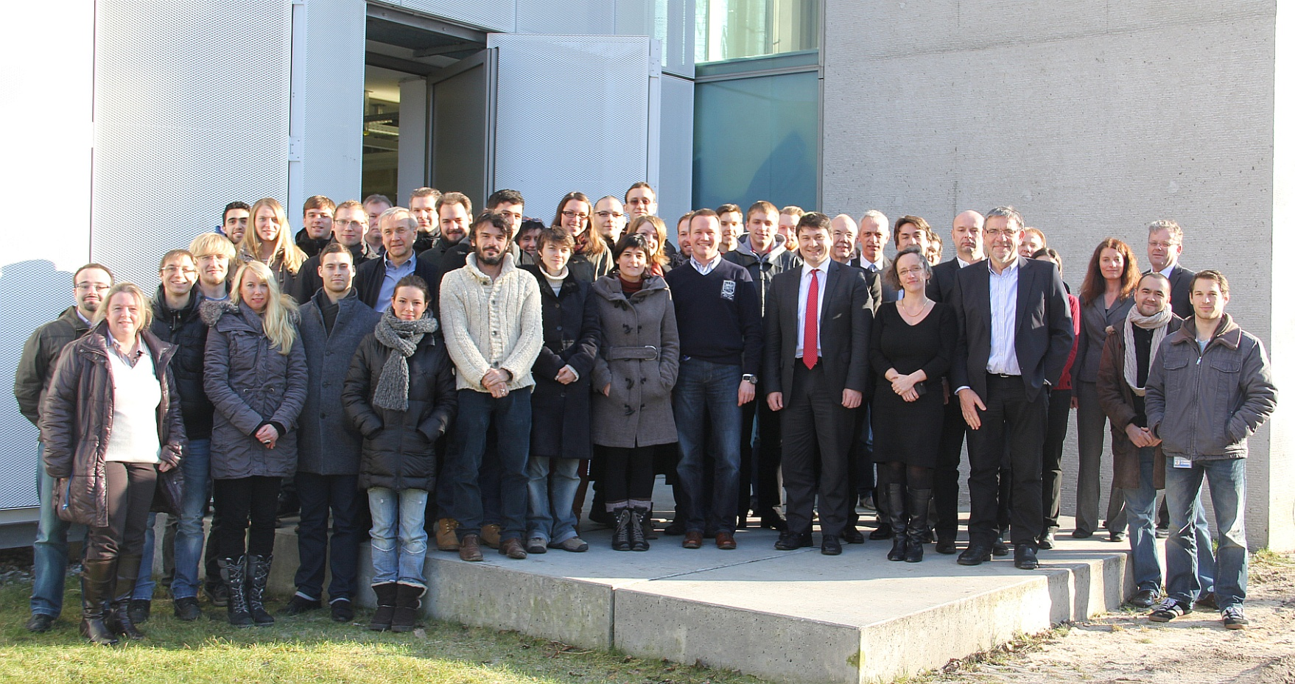
Acknowledgement
Lukas.winter@ptb.de

